Slide 1


Slide 2


Slide 3
How a Microprocessor Works
The operation of a microprocessor, though abstracted, is relatively simple to follow. The Microprocessor, can be somehow likened to the brain of a human being. As so, it is often known as the Brain of the computer.
They work on based on digital logics. Every instruction is executed by a series of logic circuits that work on the principles of the different types of logic gates.
A microprocessor executes a collection of machine instructions that tell the processor what to do. Based on the instructions, a microprocessor does three basic things:
•Using its ALU (Arithmetic/Logic Unit), a microprocessor can perform mathematical operations like addition, subtraction, multiplication and division. Modern microprocessors contain complete floating point processors that can perform extremely sophisticated operations on large floating point numbers.
•A microprocessor can move data from one memory location to another.
•A microprocessor can make decisions and jump to a new set of instructions based on those decisions.

Slide 4
INTRODUCTION
Our microprocessor is based on the MIPS architecture. It is a single cycle processor which basically
Fetches
Decode
Execute
Store/Write Back(optional)

Slide 5
COMPONENTS OF THE PROCESSOR
Registers
Control Unit
Arithmethic Logic Unit(ALU)
Memory(RAM)

Slide 6
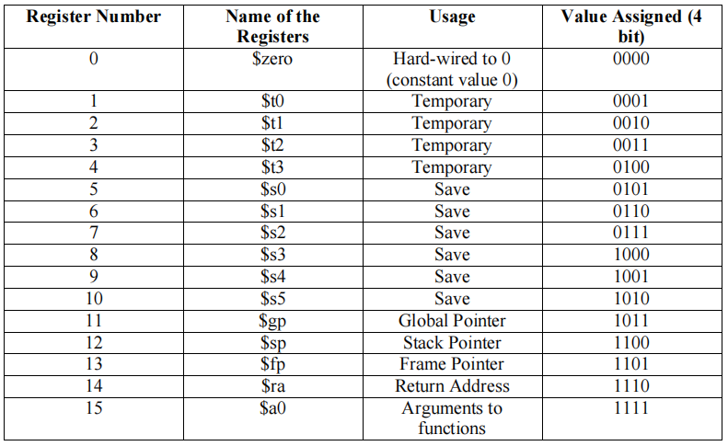
Registers
Registers are all 16 bit.

Slide 7
MIPS ISTRUCRTION SET
MIPS is made up of 3 basic instruction components
R-Type Instruction
I-Type Instruction (Immediate Type)
J-Type Instruction (Jump)

Slide 8
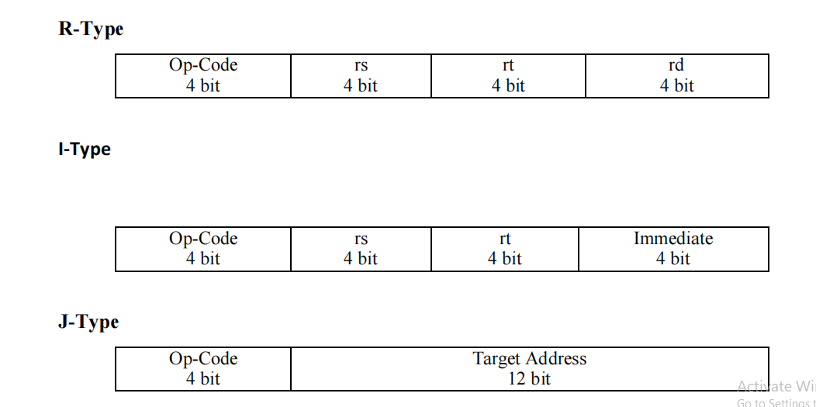
FORMAT

Slide 9
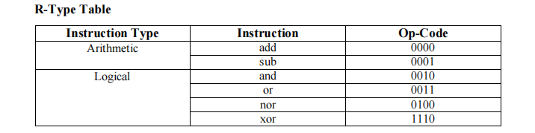
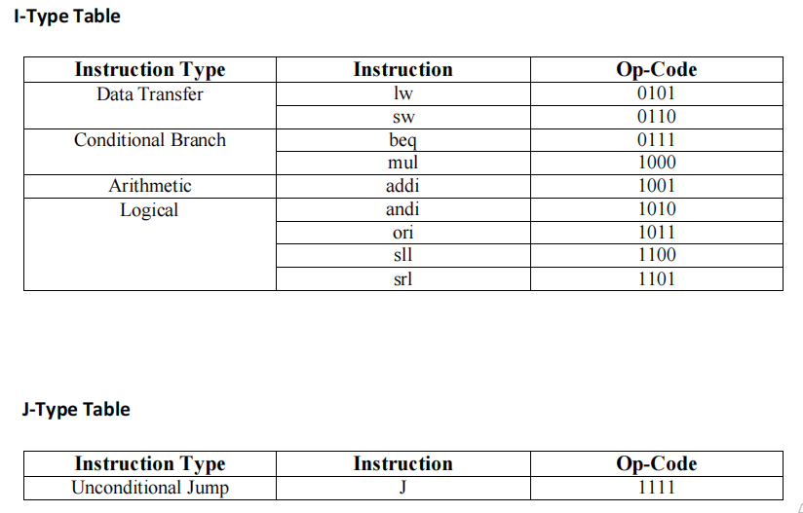
OPERATIONS

Slide 10
MIPS OPERATIONS
add:
It adds the content of the source register 1 to the contents of the source register 2 and saves it in
the destination register.
Operation: $s0 = $s0 + $t0
Syntax: add $s0, $s0, $t0
sub:
It subtracts the content of the source register 2 from the contents of the source register 1 and
saves it in the destination register.
Operation: $s0 = $s0 - $t0
Syntax: sub $s0, $s0, $t0

Slide 11
MIPS OPERATIONS
and:
It does a bit by bit logical and operation between two source registers contents.
Operation: $s0 = $s0 & $t0
Syntax: and $s0, $s0, $t0
or:
It does a bit by bit logical or operation between two source registers contents.
Operation: $s0 = $s0 ||
$t0Syntax: or $s0, $s0, $t0
nor:
It does a bit by bit logical “nor” operation between two source registers contents.
Operation: $s0 = ~ ($s0 | $t0)
Syntax: nor $s0, $s0, $t0

Slide 12
MIPS OPERATIONS
slt:
It compares the contents of two source registers. If the content of 1st source register is less than
the second source register, then it sets the value of destination register to 1, otherwise 0
Operation: if ($s0 < $t0)
$s0 = 1
Else $s0 = 0
Syntax: slt $s0, $s0, $t0
lw:
It loads the contents of the memory specified by the offset and saves it into a destination register.
Operation: $s0 = Memory [$s1 + offset]
Syntax: lw $s0, 2($s1)
sw:
It stores the contents of a source register to the memory address specified by the offset
Operation: Memory [$s1 + offset] = $s0
Syntax: sw $s0, 2($s1)

Slide 13
MIPS OPERATIONS
beq:
It checks if the content of the provided register is equal to the contents of another register or not.
If equal jumps a relative number of instructions else continue.
Operation: if ($s0==$t0) jump to L (Label)
Else go to next line
Syntax: beq $s0, $t0, L
bne:
It checks if the content of the provided register is not equal to the contents of another register or
not. If not equal, jumps a relative number of instructions else continue.
Operation: if ($s0 != $t0) jump to L (Label)
Else go to next line
Syntax: bne $s0, $t0, L
addi:
It can add direct value (constant) with a content of a source register.
Operation: $s0 = $t0 + immediate value
Syntax: addi $s0, $t0, 4

Slide 14
MIPS OPERATIONS
andi:
It does logical bit by bit and operation with a constant value and a content of a source register.
Operation: $s0 = $t0 & immediate value
Syntax: andi $s0, $t0, 4
ori:
It does logical bit by bit or operation with a constant value and content of a source register.
Operation: $s0 = $t0 || immediate value
Syntax: ori $s0, $t0,
srl:
This operation shifts the content of a register to right by a constant and stores shifted
value todestination register.
Operation: $s0 = $t0
>> 4Syntax: srl $s0,
$t0, 4

Slide 15
MIPS OPERATIONS
sll:
This operation shifts the content of a register to left by a constant and stores shifted
value todestination register.
Operation: $s0 = $t0
<< 4Syntax: sll $s0,
$t0, 4
J:
It jumps a relative number of instruction/s specified by given label
number.Operation: jump to Label
Syntax: J, L

Slide 16
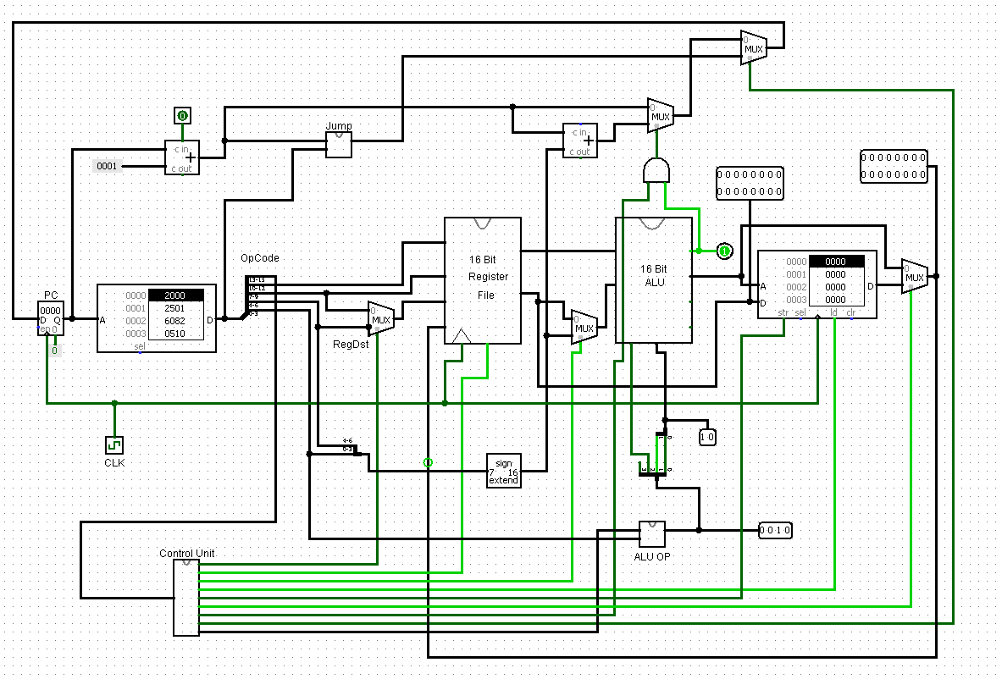
THE MAKETZ PROCESSOR

Slide 17
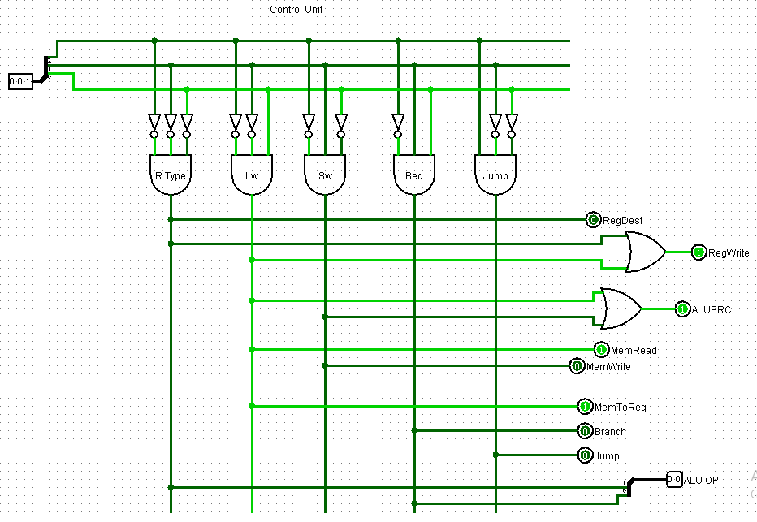
CONTROL UNIT

Slide 18
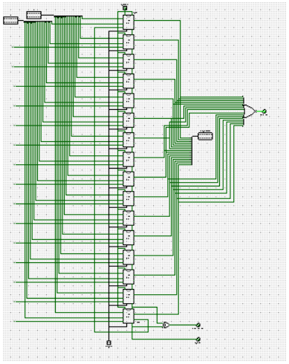
16 BIT ALU

Slide 19
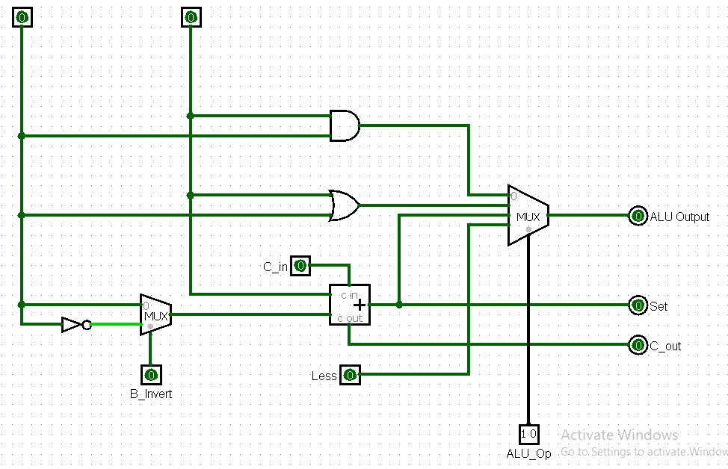
1 BIT ALU

Slide 20
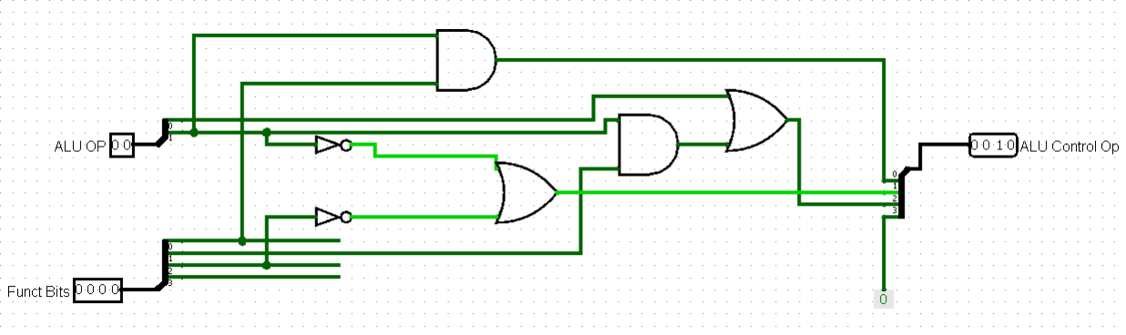
ALU CONTROL

Slide 21
Operation of our ALU
The operation of the ALU is relatively simple and straight forward. Two inputs A and B are connected to the abstracted operation logic circuits. Once there is an input, the ALU executes that particular instruction and return a desired output in 16-bit. The result of the operation is sent into the multiplexer connected to our 16-bit register where it is written to.

Slide 22
INSTRUCTION FETCHING
The CPU is always in an infinite loop, fetching
instructions from memory and executing them
The program counter or PC register holds the
address of the current instruction and points to the next instruction

Slide 23
DECODING

